Slide 1
Project:
Stock Prices Prediction

Slide 2

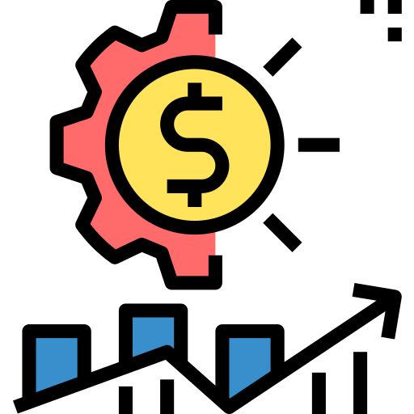
Purpose
Create a model that predicts possible ups and downs in order to suggest investment.
Notes:
Using Yahoo Finance to create a model that helps predict possible ups and downs in order to suggest people or companies to invest.

Slide 3
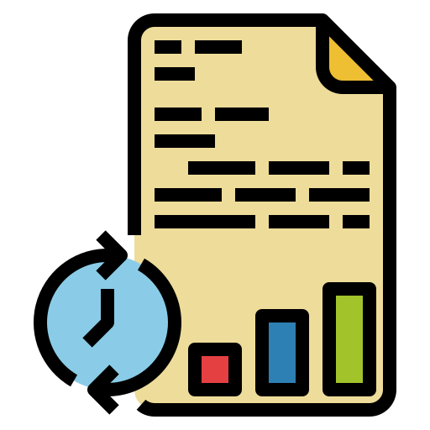



Why?
Real Data
Skills improvement
Useful to invest
Notes:
Using Real Data from Yahoo Finance in order to predict the best possible investment (in this case without considering the specific price of the stock), there is a need to improve the Machine Learning Skills and also data skills in order to develop a model that can be useful in order to invest wisely.

Slide 4
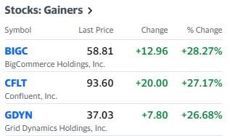
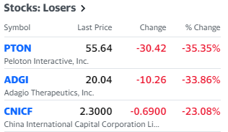
Data Source
Notes:
Yahoo Finance is a media platform that provides financial news, data about stock quotes, press releases, and financial reports. And all the data provided by Yahoo Finance is free. Yahoo Finance API is the API that Yahoo provides to fetch financial information.

Slide 5
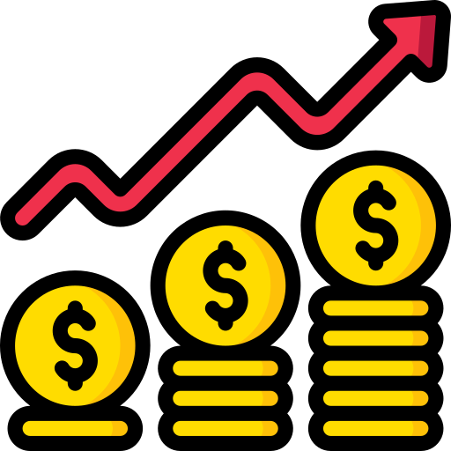


Questions to Answer
?
How to invest?
Which are the best stock options?
Notes:
Advise people or even companies about how to invest their money in the market with potential good results or even take a better decisions in our own investments.
Using the model suggest the ones that have a better performance and after that check which ones will be the ones that can make the best profit possible.

Slide 6


Data Exploration Phase
Scrap the information containing the stock data.
pip install yfinance
source: https://pypi.org/project/yfinance/
Notes:
Scraping the information containing the stock data the columns Date, Open, High, Low, Close, Adj Close, Volume and Name, were obtained.

Slide 7

Analysis Phase
Data extraction
Data exploration
Database
Data preprocessing
Data Training
ML models
Predictors
Dashboard dummy
Notes:
Make a model that helps predict possible ups and downs in the market using Time series model and Machine learning models, specially Support Vector Machine and Artificial Neural Networks, the data will be tested and trained to try to accomplish a good percent of accuracy.

Slide 8
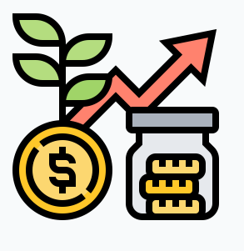
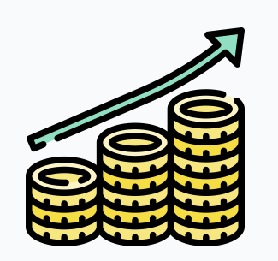

Dashboard
Notes:
Tableau will be used by implementing different dashboards and stories. Also data studio from google will be tested for possible dashboard.

Slide 9



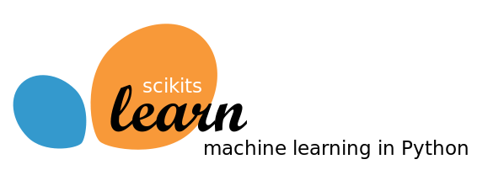





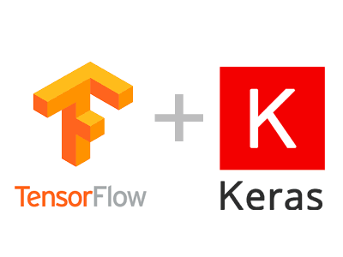


Programming tools
Real Data
Skills improvement
Useful to invest
Notes:
Tableau will be used by implementing different dashboards and stories. Also data studio from google will be tested for possible dashboard.

Slide 10
Result of analysis
Notes:
Dashboard images with results

Slide 11
Recommendation for future analysis
Notes:
Dashboard images with results

Slide 12
Anything the team would have done differently
Notes:
Dashboard images with results

